Slide 1
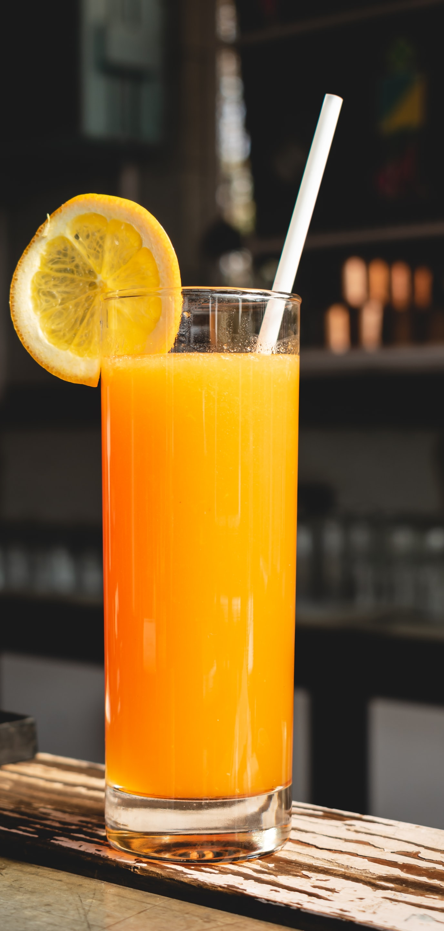

Reinventing “Freshly” company
Recommendations to rebrand key products and reinvigorate sales
Dec 2041
The material is confidential. All rights reserved.

Slide 2
You have a choice:
Remain a drink that contributes to 25% daily sugar intake
or
become a nutrient-rich and healthy lifestyle beverage

Slide 3
Executive Summary Slide:
Market insights and difficulties for fruit juice sales:
“Freshly” Fruit Juice sales experience significant decrease due to healthier alternatives
Increasing water and nutrient-rich beverage consumption is a challenge for sweetened drinks
Problems can create new opportunities:
As previous year sales show, “Freshly” Fruit Beverage won’t be sustainable for the company in its current form
Age 20-market to be the most appropriate and reachable target for “Freshly” to reestablish brand position and reinvigorate sales
4 recommendations for the Company as their next steps:
Education - Demistify what causes diseases and what sugars are in your product
Promotion - Become an ambassador of a healthy event
Adjustment - Stay in compliance with government standards
Rebranding - Cater to a younger audience (20-39)

Slide 4

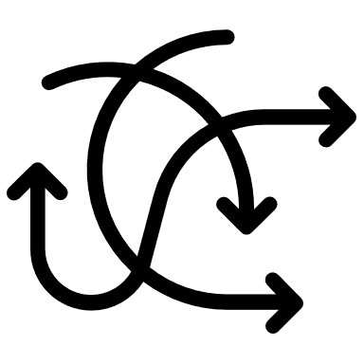

Executive Summary Slide:
Market evaluation
Problems & opportunities
Proposed changes
“Freshly” Fruit Juice sales experience significant decrease due to healthier alternatives
Increasing water and nutrient-rich beverage consumption is a challenge for sweetened drinks
As previous year sales show, “Freshly” Fruit Beverage won’t be sustainable for the company in its current form
Age 20-market to be the most appropriate and reachable target for “Freshly” to reestablish brand position and reinvigorate sales
4 recommendations for the Company as their next steps:
Education - Demystify what causes diseases and what sugars are in your product
Promotion - Become an ambassador of a healthy event
Adjustment - Stay in compliance with government standards
Rebranding - Cater to a younger audience (20-39)

Slide 5
“Freshly” Fruit Juice sales experience significant decrease due to healthier alternatives
Key takeaways between 2039 and 2040:
Sales volume between 2039 and 2040 reduced by 300 thousand units
Gross revenue 5% lower (from 174 mln USD in 2039 to 165 mln in 240 mln
„Freshly” Fruit Juice is mostly sold in stores
Online sales make up only 13% of total sales
Unit sales experience a slow but consistent decline
-300,000 unit sales

Slide 6
Increasing water and nutrient-rich beverage consumption is a challenge for sweetened drinks

Slide 7
As previous year sales show, “Freshly” Fruit Beverage won’t be sustainable for the company in its current form
Sugary drinks are stigmatized, marked as partial cause for diabetes, heart disease and obesity
Fruit beverages are 5,3 % intake in the US and the trend isn’t positive
Brand problems
Added artificial flavors don’t contribute to better taste and health values
Study found out that “Freshly” has increased amounts of lead of other metals. Reevaluation of sources necessary
Product problems

Slide 8
Age 20-market to be the most appropriate and reachable target for “Freshly” to reestablish brand position and reinvigorate sales
Age group
Market evaluation
Comment
20y
Healthy and well-tasting products are preferred. Sizeable market potential
Healthy and well-tasting products are preferred. Sizeable market potential
20y – 39y
They won’t invest or purchase products that aren’t healthy, sustainable or environmentally
responsible
Habits are already formed. Good taste and
nutrients play a role
39y – 64y
Mature and cautious buyer. Gaining trust towards product can form long-term purchase preference
People are interested in a product that
positively impacts their lives
65y +
Lowest market potential. Customer tends to spend less on sugary beverages
Highest market potential with high quality and smart product placement

Slide 9




4 recommendations for “Freshly” to establish their identity as a company, raise brand awareness and product popularity
Key drivers divided into brand and product undertakings
Educate and inform
Promote healthy lifestyle
Adjust juice composition
Rebrand, establish identity
Demystify what causes diseases and what sugars are in your product
Inform about daily calorie limits
Become an ambassador of a healthy event
Launch a campaign promoting healthy lifestyle branded by „Freshly”
Stay in compliance with government standards
Add organic nutrients, widen your product range
Cater to a younger audience (20-39)
Form healthy habits
Add value to their lives
Brand awarness
Product populiary

Slide 10
References:
https://www.cdc.gov/healthyweight/healthy_eating/water-and-healthier-drinks.html
https://www.dietaryguidelines.gov/sites/default/files/2020-12/Dietary _Guidelines_for_Americans_2020-2025.pdf#page=48
https://www.cdc.gov/healthyweight/healthy_eating/drinks.html
https://www.cdc.gov/obesity/downloads/early-childhood-drinking-water-toolkit-final-508reduced.pdf
https://www.statista.com/statistics/387199/us-consumption-share-of-beverages-by-segment/
https://www.cdc.gov/nchs/products/databriefs/db376.htm
https://www.statista.com/statistics/387199/us-consumption-share-of-beverages-by-segment/
https://bottledwater.org/bottled-water-consumption-shift/
https://bottledwater.org/bottled-water-advertising/
Special thanks to:
Author would like to thank Joe Joel for sharing information about bottled water and fruit juice sales within His company “Juicer”.

Slide 11
Reinventing “Freshly” company
Thank you for listening Ready for questions
Dec 2041
The material is confidential. All rights reserved.

